Slide 1
AI In the Classroom
Dave Black
Lutheran High School
David.Black@LHSParker.org
faithedtech.org

Slide 2

Image of Lutheran school superintendents
meeting to learn more about AI

Slide 3
AI Acronyms!
Identify and define the following

Slide 4
AI
Artificial Intelligence — the ability of machines to mimic human intelligence

Slide 5
ML
Machine Learning — where machines automatically learn from past experiences

Slide 6
NLP
Natural language processing — the process by which computers analyze spoken and writing language

Slide 7
LLM
Large Language Model — the use of AI algorithms and huge datasets to understand, analyze, and generate content (there are also MLM and SLMs)

Slide 8
GPT
Generated Pre-Trained Transformers — a set of algorithms designed to generate new text, images, and audio from large datasets. A proprietary LLM.

Slide 9
CHALLENGES and OPPORTUNITIES

Slide 10

Tour guide, not an expert

Slide 11

Content for Today
What I have learned about AI and education
Scenarios
Crystal ball
Resources

Slide 12


Slide 13
SCENARIOS

Slide 14
Scenario #1
A student was working on a writing project. The classroom teacher decided to run the wording through an AI detector. The detector determined with a 76% likelihood that the content was AI generated. The teacher then applied a “zero” for the assignment for plagiarism. However, the student became livid, insisting that the work was their own and the generator was inaccurate. How would you encourage the school/teacher to respond?

Slide 15
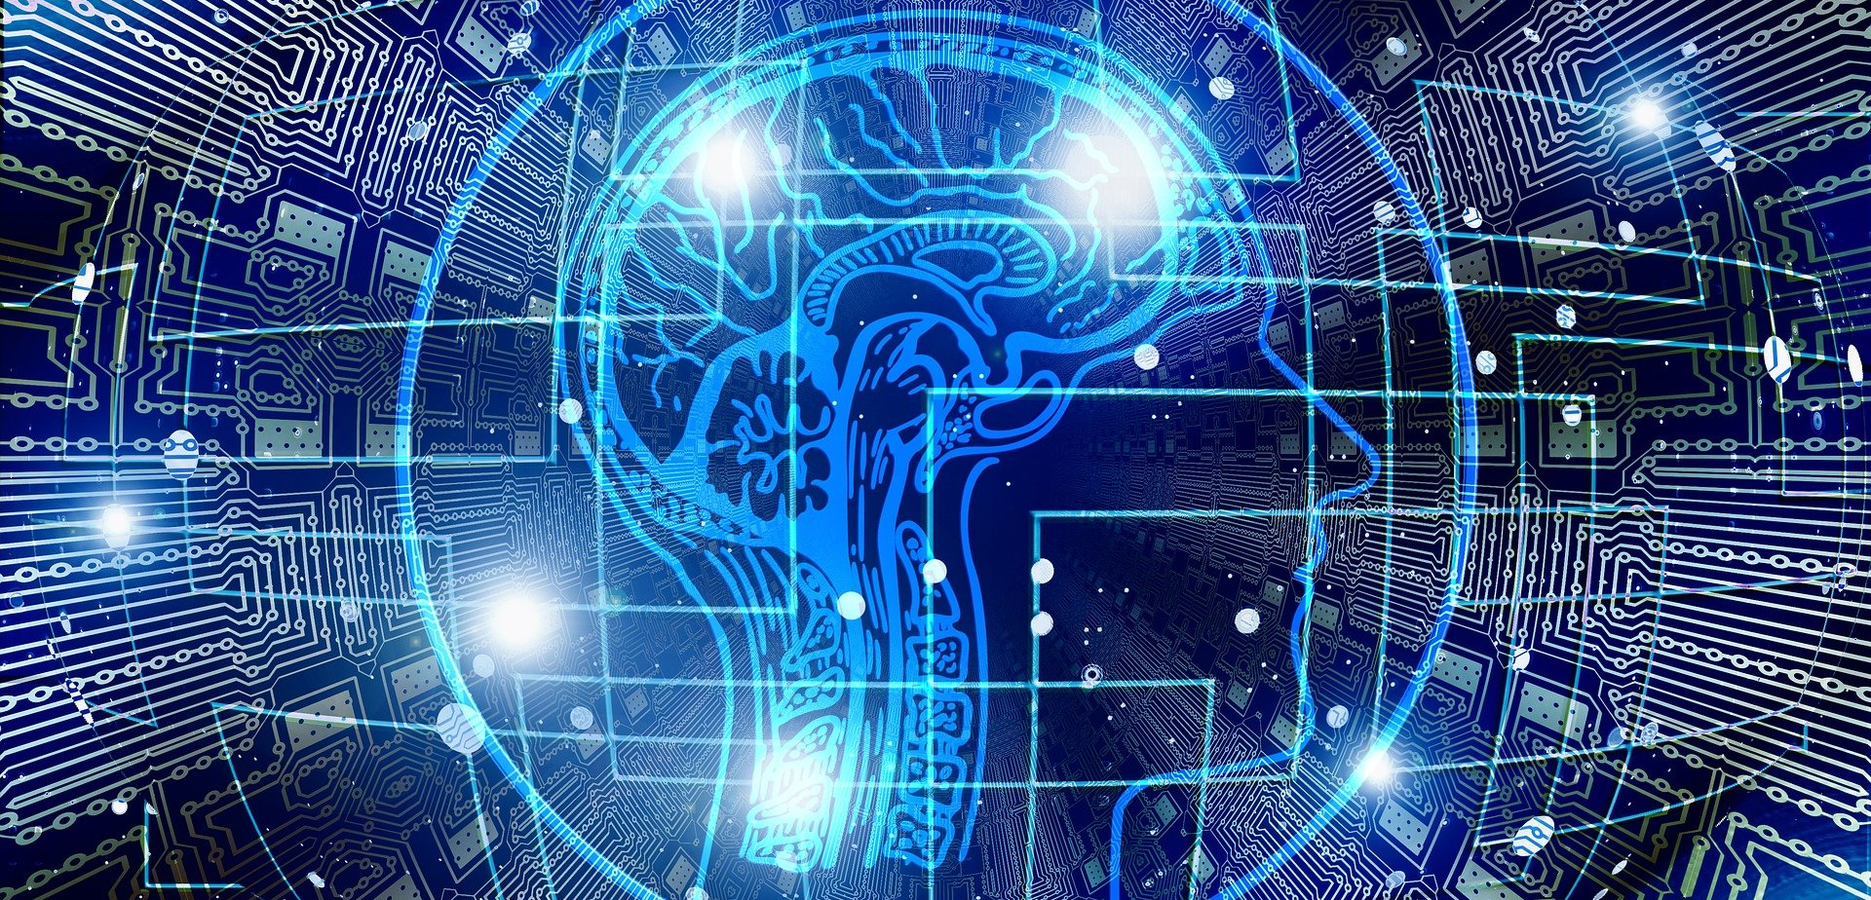
What I have Learned about AI

Slide 16
The WORST AI is now

Slide 17
Conversation vs. “Gotcha”

Slide 18
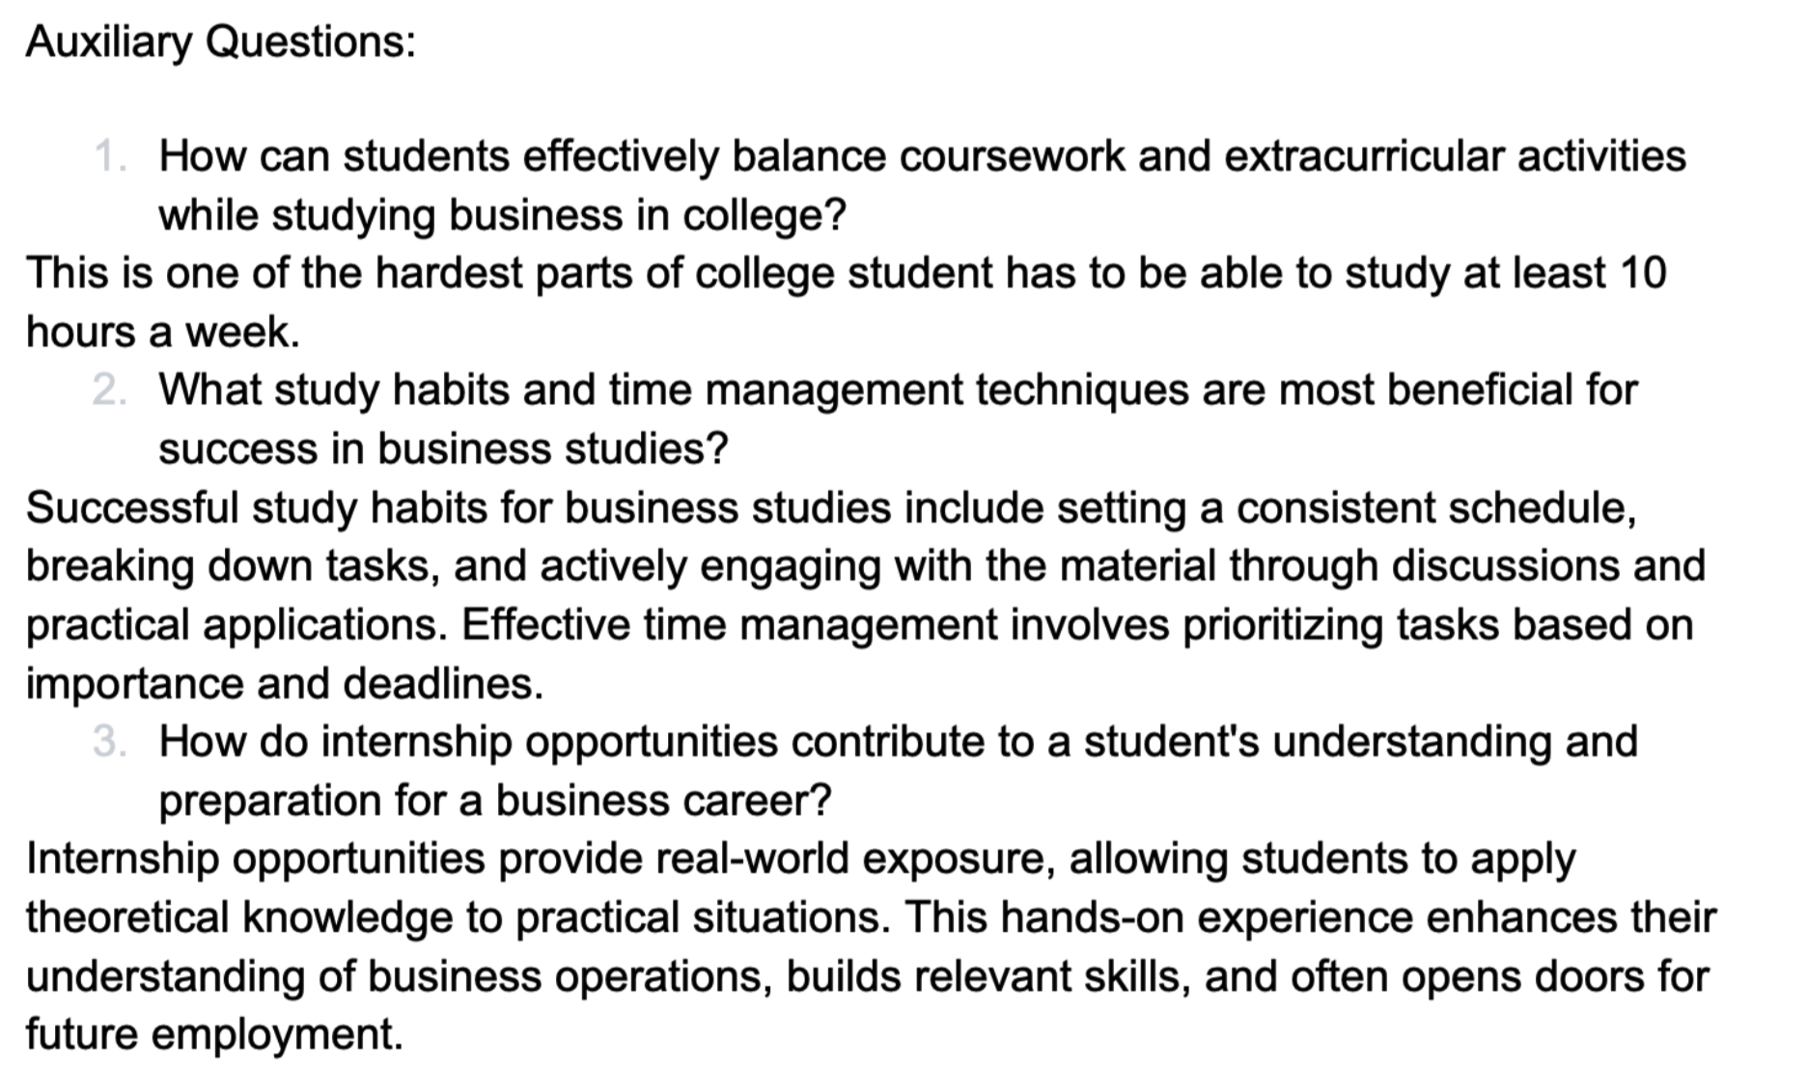

Slide 19
Transparency

Slide 20
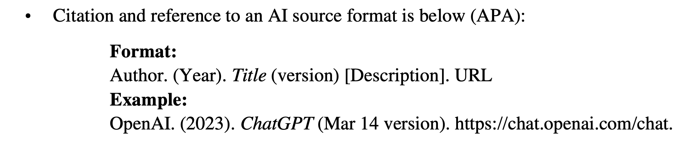

Slide 21
Scenario #2
A parent complains that AI was introduced or used in a classroom. They claim that AI is evil because it comes close to “playing God” by using something with human-like thinking and qualities. How would you encourage a school and/or teacher to respond?

Slide 22
Authentic Learning
vs. Shortcuts

Slide 23
Articulating the “Why”

Slide 24
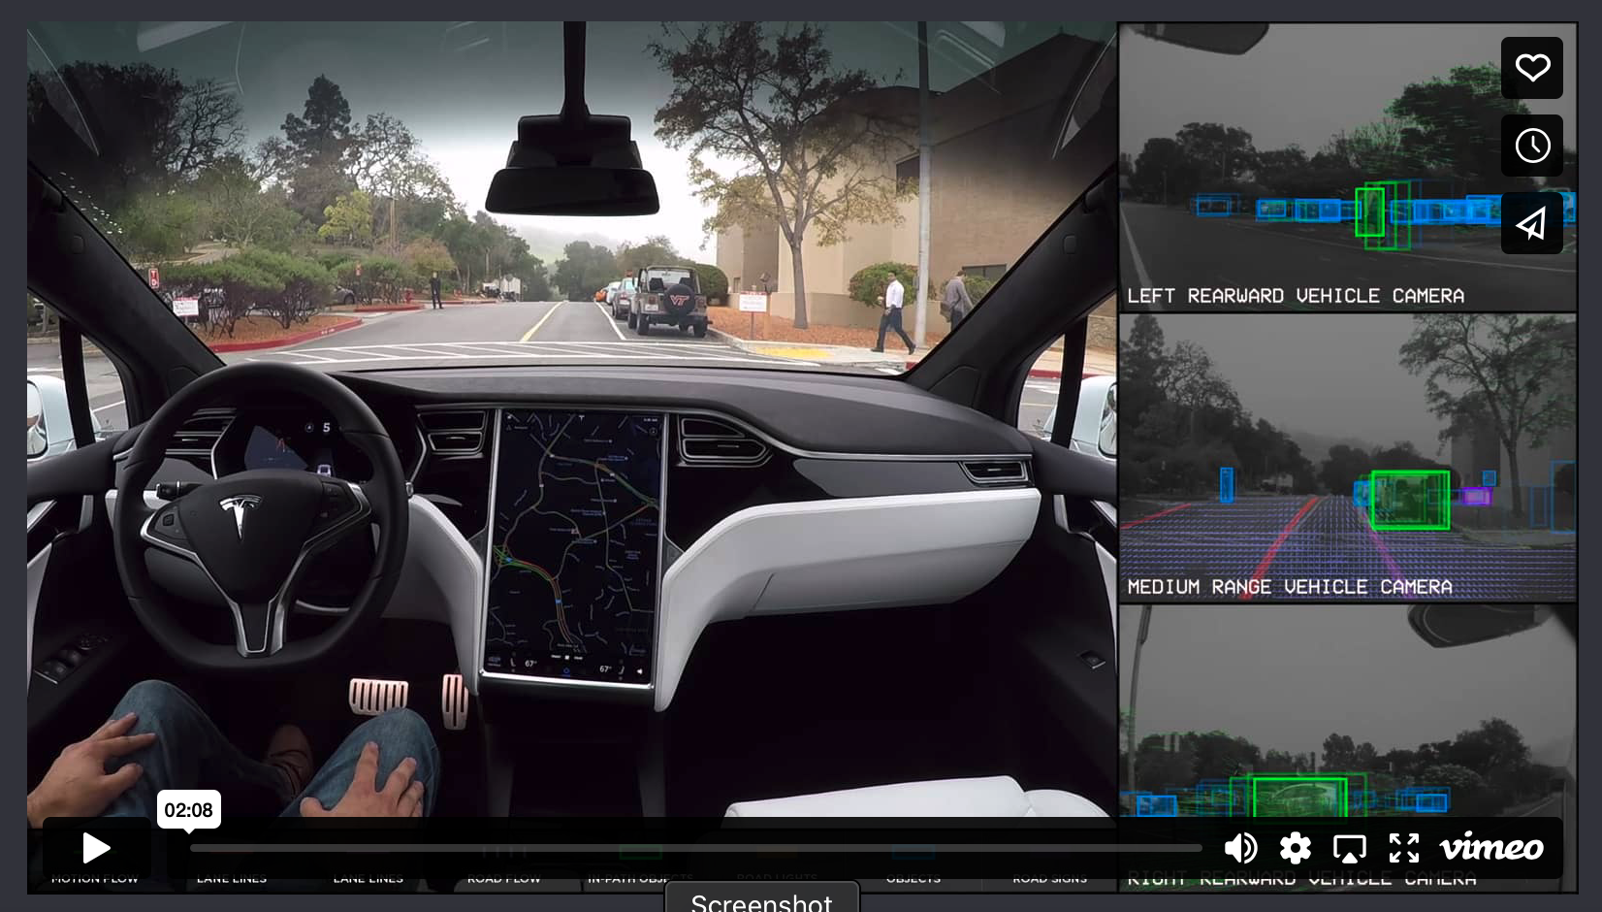

Slide 25
Dealing with
Hallucinations

Slide 26
Scenario #3
One of the concerns with AI is whether harmful biases may emerge in the results of queries, especially if the results are opposed to Christian beliefs. What are some ways you would encourage teachers and schools to identify bias and address these findings within the learning process?

Slide 28
Four Issues to Watch For AI’s Potential Growth
Limited additional data sources
Power
Legal issues
Monetizing of AI

Slide 29
Greater Use of MLMs and SLMs to target specific educational goals, such as tutoring, executive functioning assistance, etc.

Slide 30
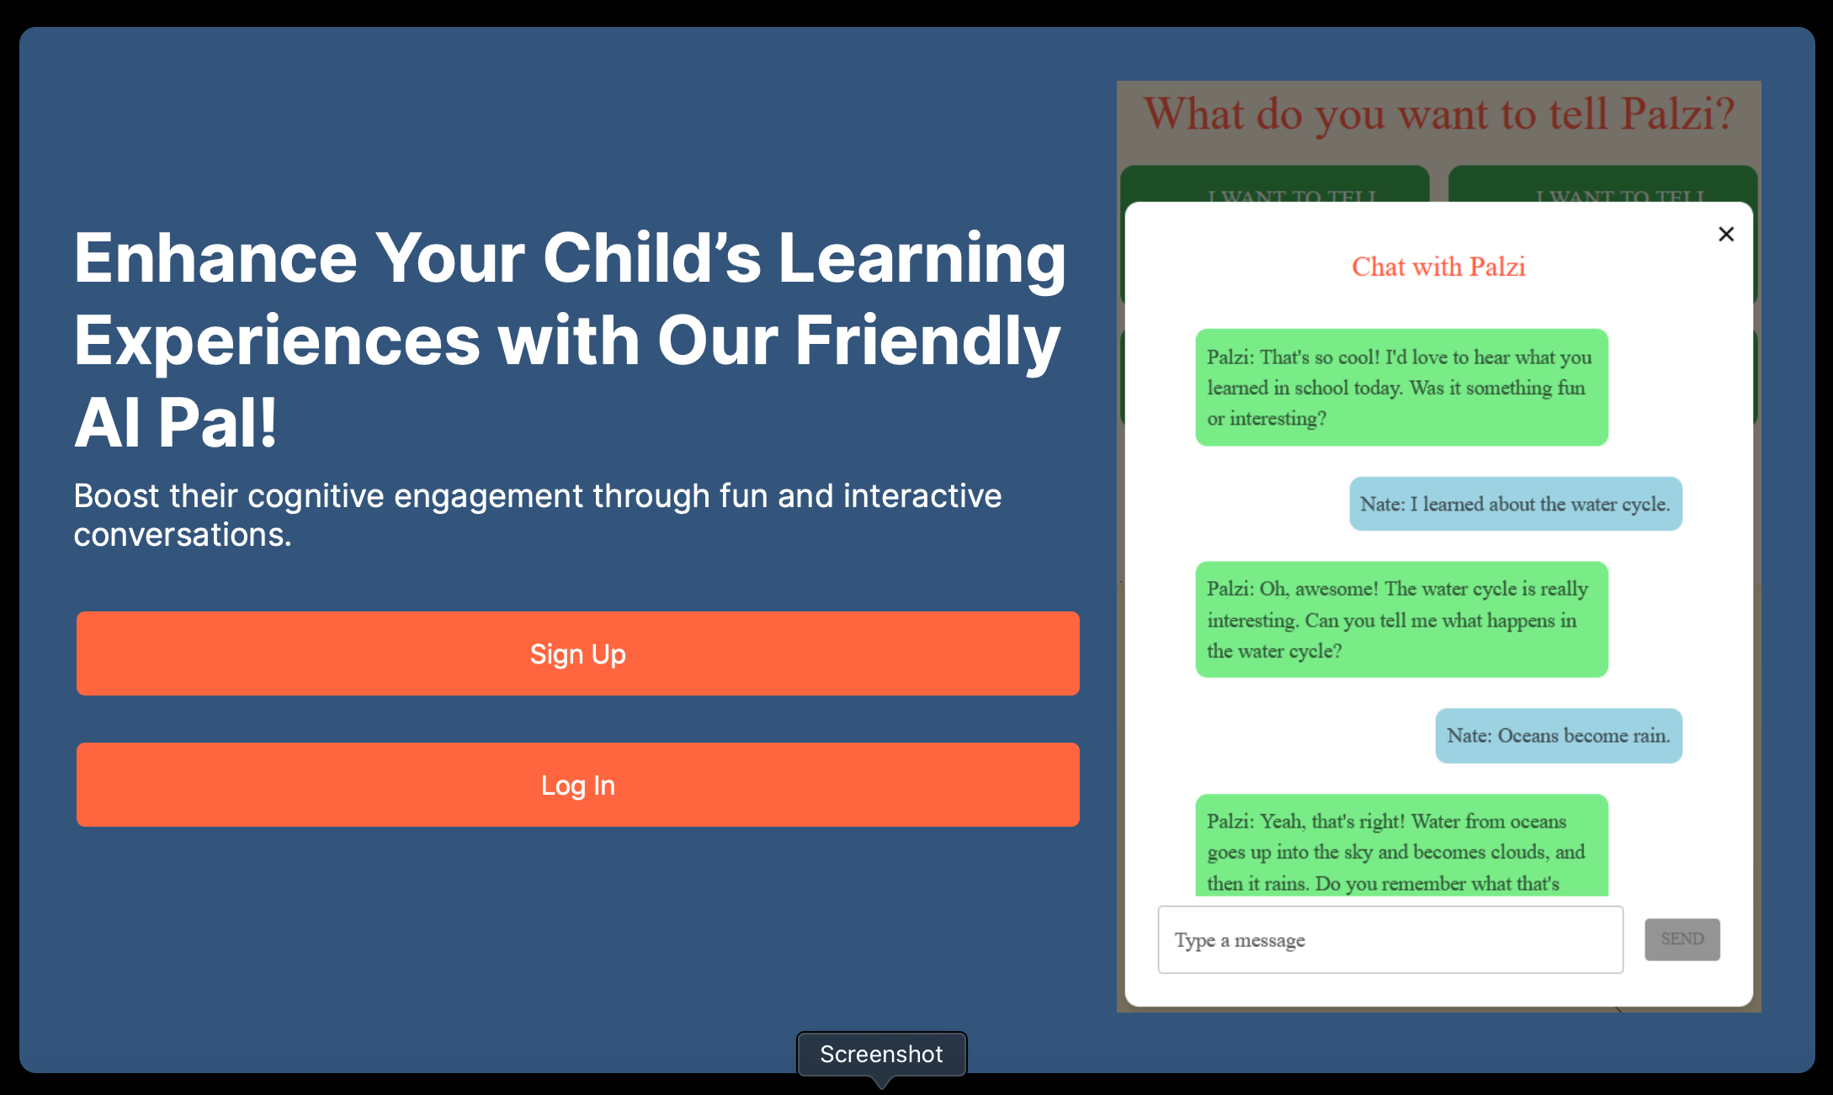
Example: palzi.org

Slide 31
Executive Functioning

Slide 32

GitMind AI

Slide 33
The Rise of AI Generated Video

Slide 34


Slide 35


Slide 36
Resources

Slide 37
AI: Destroyer of Education or a Tool?

Slide 40

FaithEdTech.org

Slide 41
AI In the Classroom
Dave Black
Lutheran High School
David.Black@LHSParker.org
faithedtech.org

