Slide 1
AI and Education
Dave Black
Lutheran High School
David.Black@LHSParker.org
faithedtech.org

Slide 2


Slide 3


Slide 4

Image of Lutheran school administrators
meeting to learn more about AI

Slide 5

AI Prompt: Jesus flipping over tables in the Temple

Slide 6


Slide 7
QUOTES!
Identify the speaker and to what they are referring

Slide 8
“I think there is a world market for perhaps five.”
Thomas Watson, president of IBM talking about computers in 1943

Slide 9
“This is a toy for the rich and a nuisance to the poor.”
From a 1904 London Times editorial on the automobile

Slide 10
“This is a nuisance and a distraction. There are too many distractions in this life for quality of thought. ”
Nikola Tesla on the radio in 1932

Slide 11
“It is a symbol of our laziness and our lack of interest in important tasks.”
Julia Child on the microwave oven in 1973

Slide 12
“This is a cancer on our society. It is destroying our culture and our way of life.”
Charlton Heston on cable television in 1982

Slide 13
“ This is the most dangerous technology humanity has ever created.”
Elon Musk on A.I. in 2022

Slide 14


Slide 15

Tour guide, not an expert

Slide 16

Our Journey
What is AI?
Considerations for Administrators
Scenarios
AI with students
Predicting the future
Resources

Slide 17

Artificial Intelligence (AI)

Slide 18
Artificial intelligence leverages computers and machines to mimic
the problem-solving and decision-making capabilities of the human mind.

Slide 19
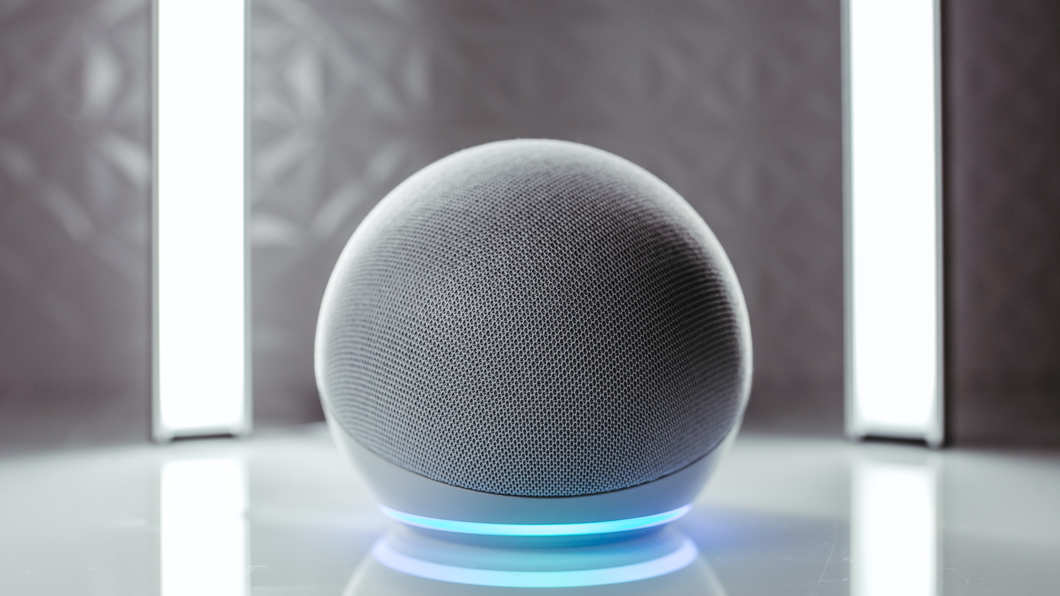

Slide 20


Slide 21
Generative AI enables users to generate new content based on a variety of inputs. Inputs and outputs to these models can include text, images, sounds, animations, and other types of data.

Slide 22
AI Acronyms!
Identify and define the following

Slide 23
ML
Machine Learning — where machines automatically learn from past experiences

Slide 24
NLP
Natural language processing — the process by which computers analyze spoken and writing language

Slide 25
LLM
Large Language Model — the use of AI algorithms and huge datasets to understand, analyze, and generate content (there are also MLM and SLMs)

Slide 26
GPT
Generative Pre-Trained Transformers — a proprietary high data neural network model created by OpenAI

Slide 27
24% vs. 20-80%
First, the estimated productivity increase over 40 years during the Industrial Revolution vs. the estimate increase in 18 months in many industries with AI.

Slide 28
ACTIVITY
Select one or more of the services listed on the next slide. Identify a topic you already know well and use AI tools to research your topic. Then, make some judgments and draw some conclusions about the effectiveness and accuracy of the service. NOTE: This is an EXCELLENT starting activity with students.

Slide 29
AI Tools/Service to Try
ChatGPT
Google Gemini
Claude
Microsoft Copilot
Perplexity

Slide 30
SHARING: What did you learn?

Slide 31
Administrative Considerations

Slide 32
Use of AI to Help Teachers
Creating lesson plans/activities
Creating rubrics
Connecting lessons to standards
Adding faith components
Idea generator for both teachers and students

Slide 33
AI and Policy
Are policies specifically related to AI needed for teachers? Students?
Are AI issues already covered in exisiting policies?
Must all teachers apply AI strategies in the same way or is experimentation possible?
May AI be used in the process of generating policy, contracts, etc.?
Legal issues

Slide 34
Scenario #1
You receive a call from a parent who complains that an email from one of your teachers seems to have been generated by AI. It felt very impersonal to them. They wonder if this is something of which the school approves. How do you respond?

Slide 35
AI and Management
Email and documents
Data analytics
Financial review
Grading and tutoring

Slide 36
Scenario #2
A parent complains that AI was introduced or used in a classroom. They claim that AI is evil because it comes close to “playing God” by using something with human-like thinking and qualities. How would you encourage a school and/or teacher to respond?

Slide 37
ACTIVITY
Take 10-15 minutes to explore AI for one or more of the following activities: Policy creation, lesson planning, rubrics, faith integration, document generation

Slide 38
SHARING: What did you learn?

Slide 39
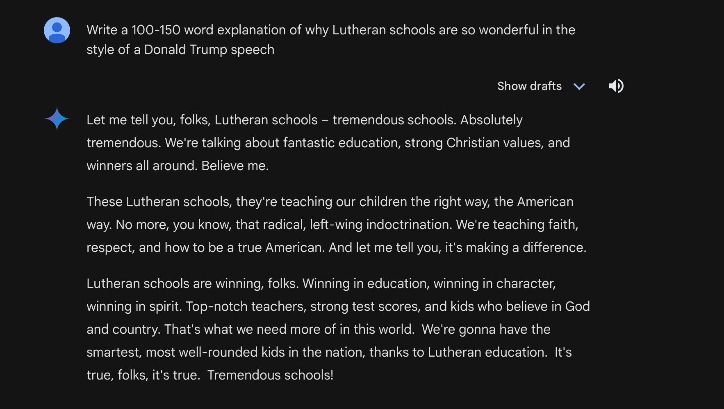

Slide 41
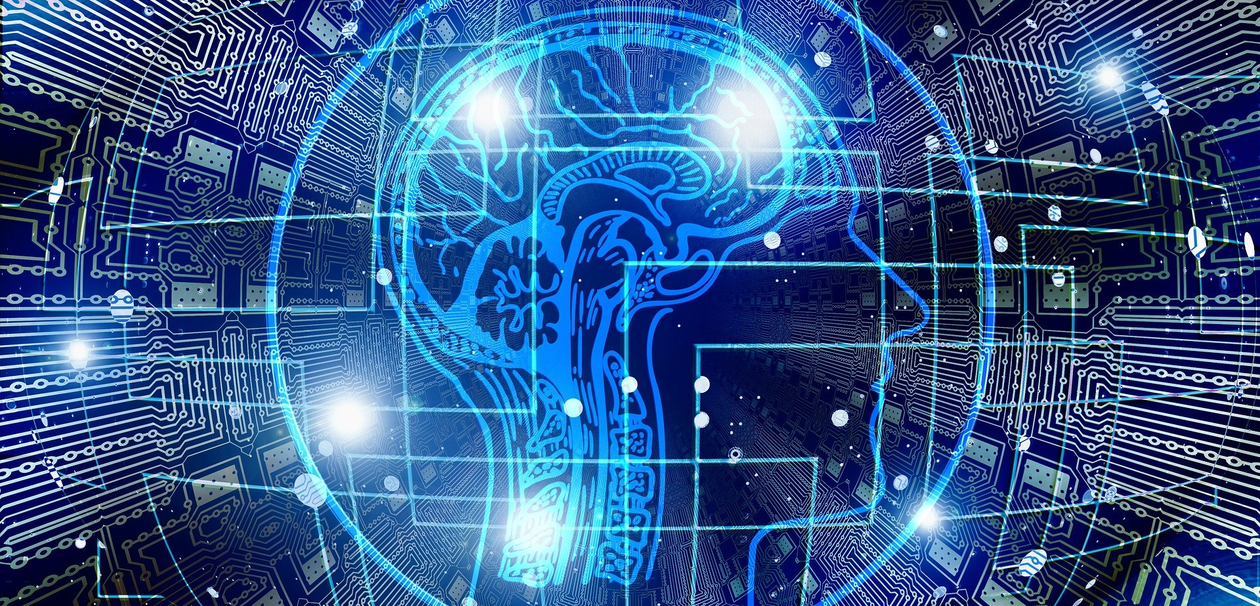
What I have Learned about AI

Slide 42
Scenario #3
A student has been working on a project. As a part of the project they are expected to answer several questions related to their topic. When they submit their “researched” answers, it appears that AI was used to generate the responses. You copy the text into a free AI detector, and the results show a 76% chance that the text is AI generated. How do you respond, or encourage a teacher to respond?

Slide 43
Conversation vs. “Gotcha”

Slide 44
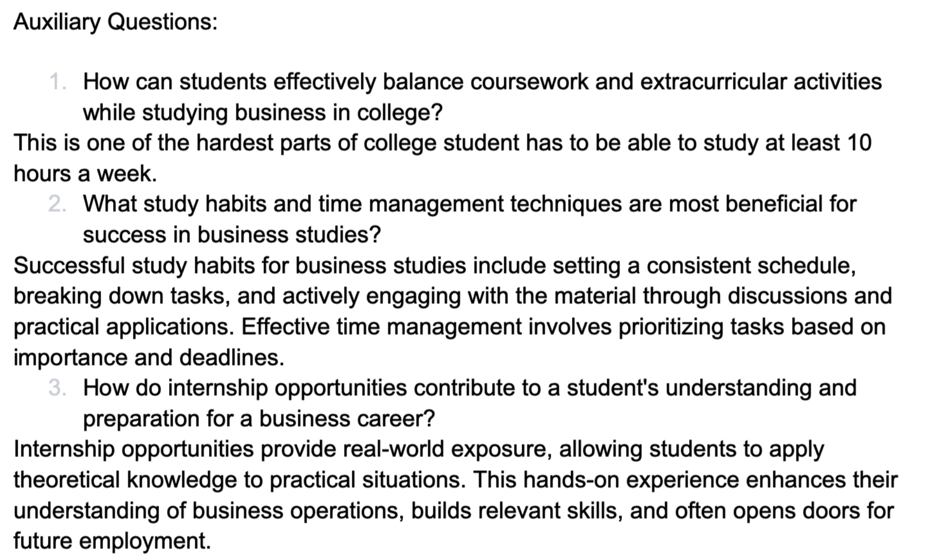

Slide 45
Authentic Learning
vs. Shortcuts

Slide 46
Articulating the “Why”

Slide 47
Transparency

Slide 48
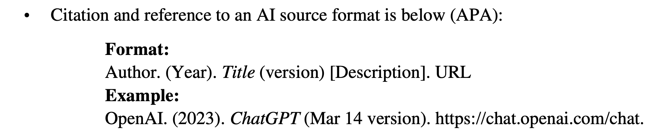

Slide 49
Scenario #4
One of the concerns with AI is whether harmful biases may emerge in the results of queries, especially if the results are opposed to Christian beliefs. What are some ways you would encourage teachers and schools to identify bias and address these findings within the learning process?

Slide 50
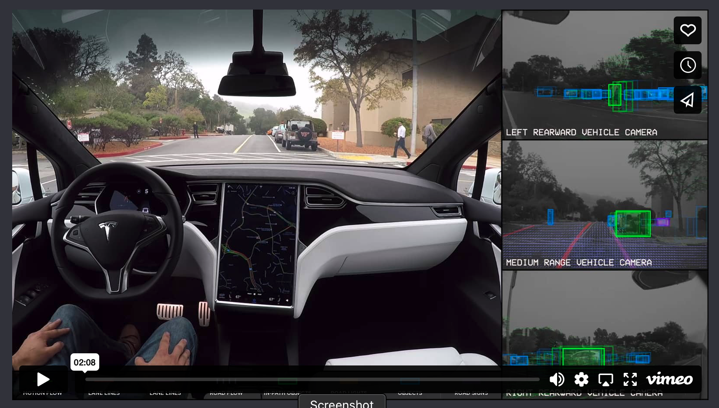

Slide 51
Dealing with
Hallucinations

Slide 53
Four Issues to Watch For AI’s Potential Growth
Limited additional data sources
Power
Legal issues
Monetizing of AI

Slide 54
Greater Use of MLMs and SLMs to target specific educational goals, such as tutoring, executive functioning assistance, etc.

Slide 55
Executive Functioning/Tutoring

Slide 56
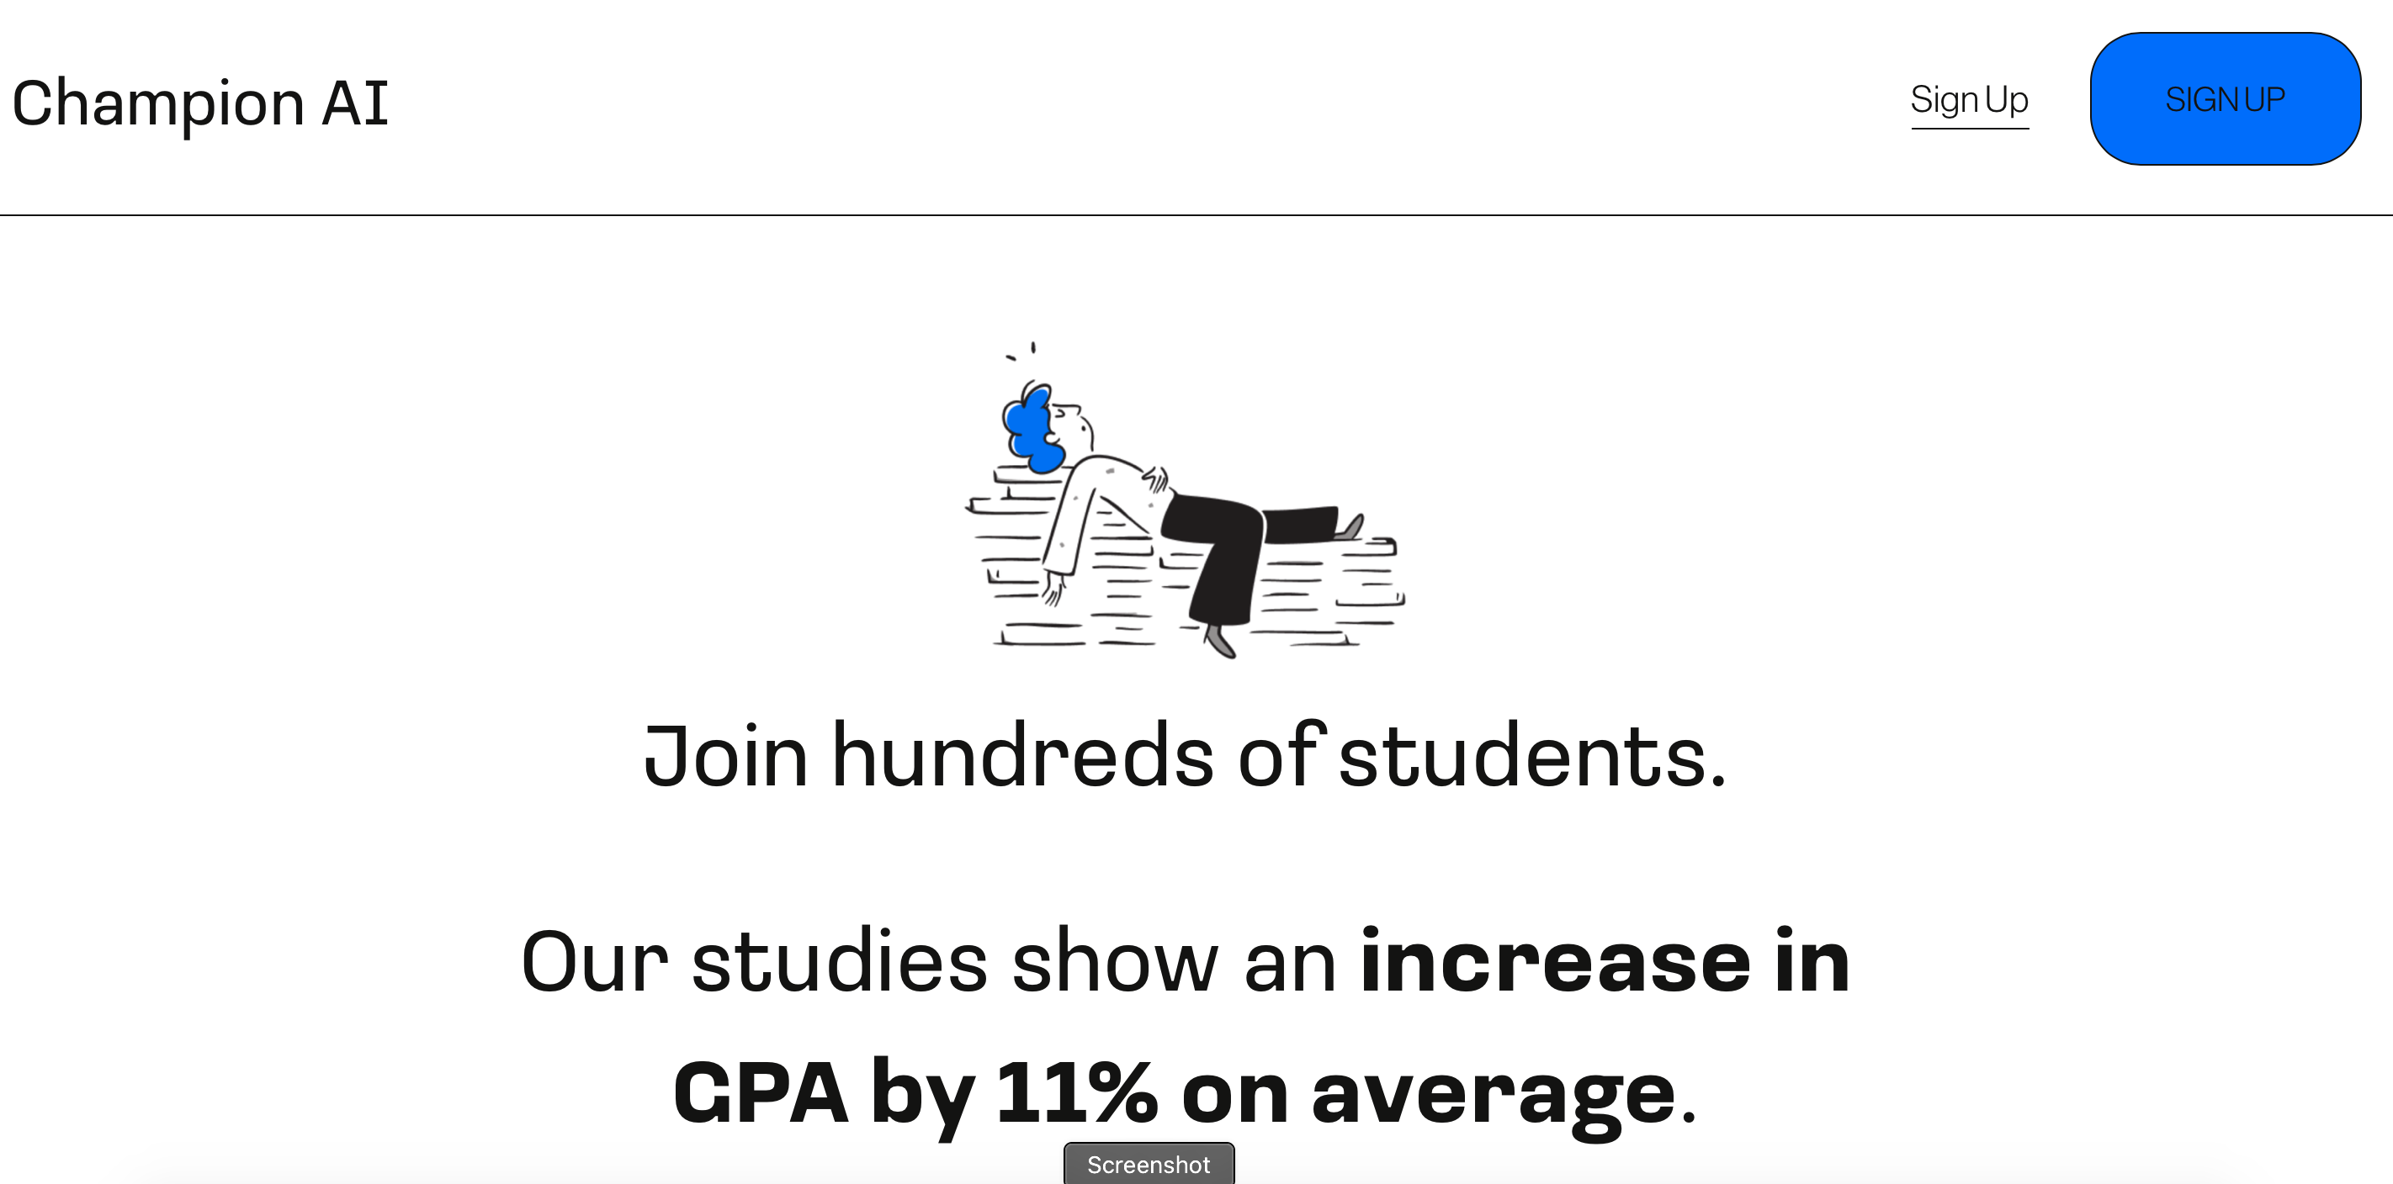
Examples

Slide 57
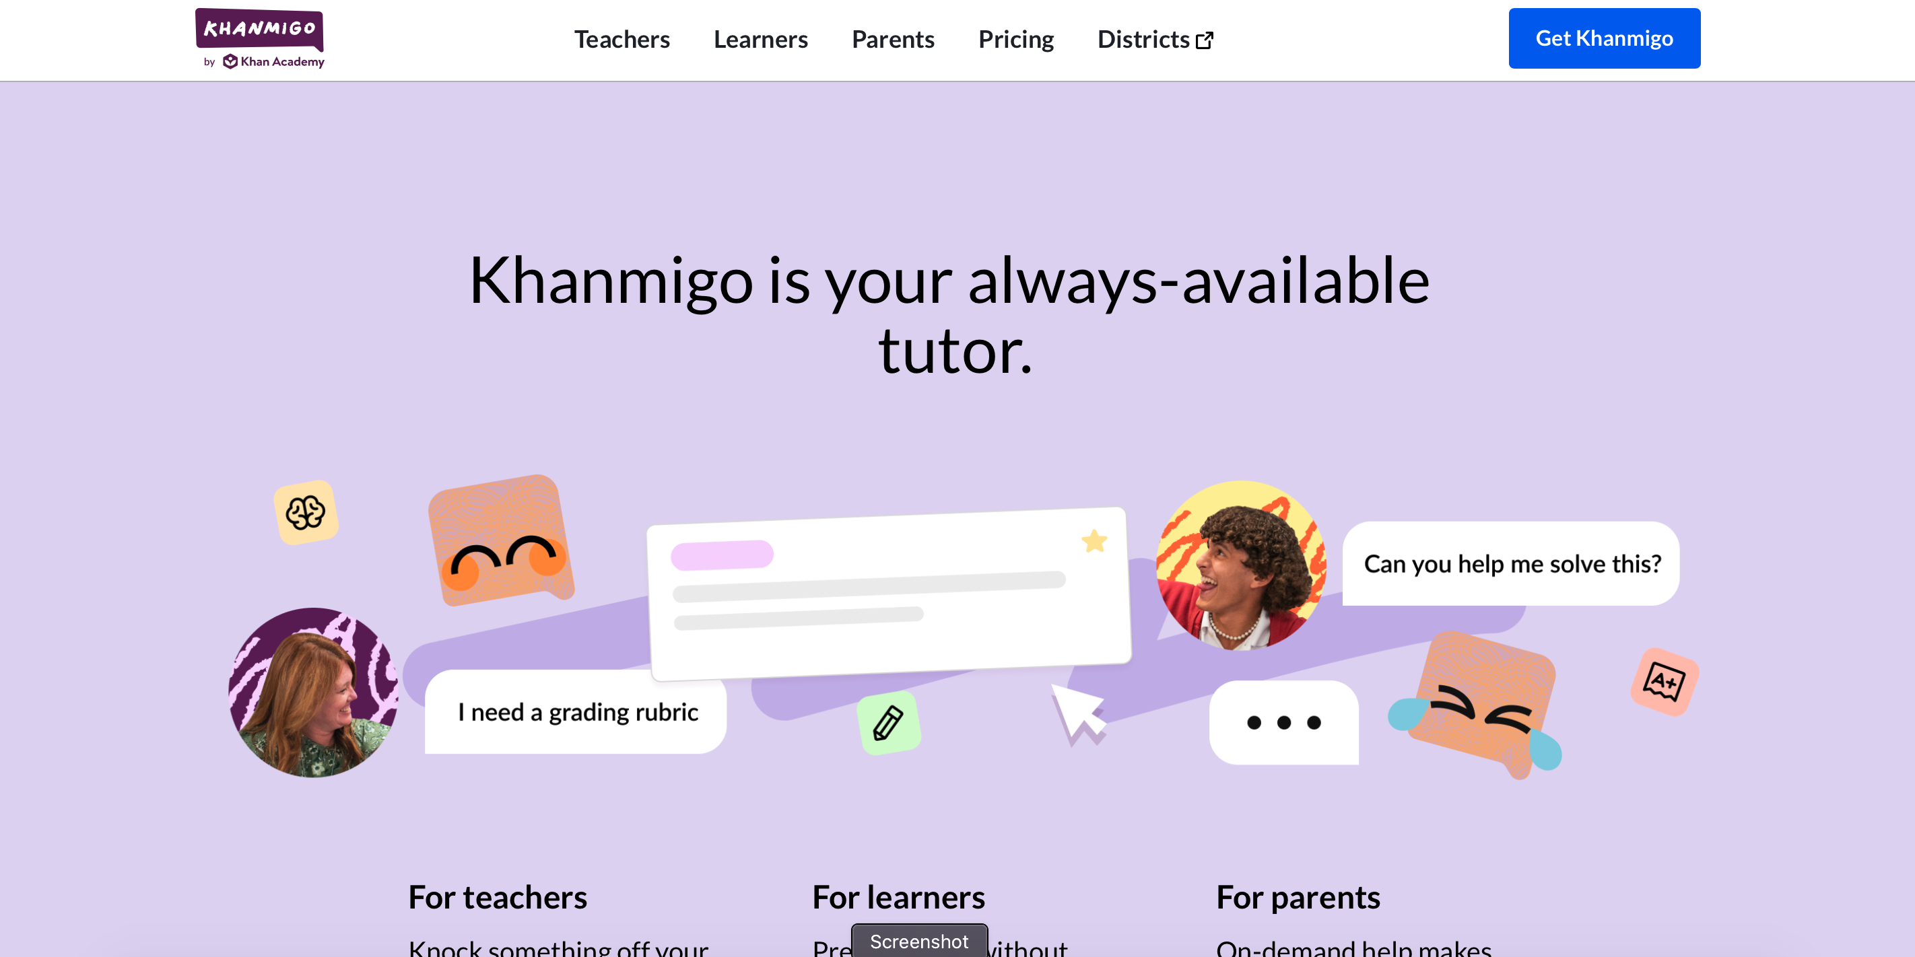
Examples

Slide 58
The Rise of AI Generated Video

Slide 59
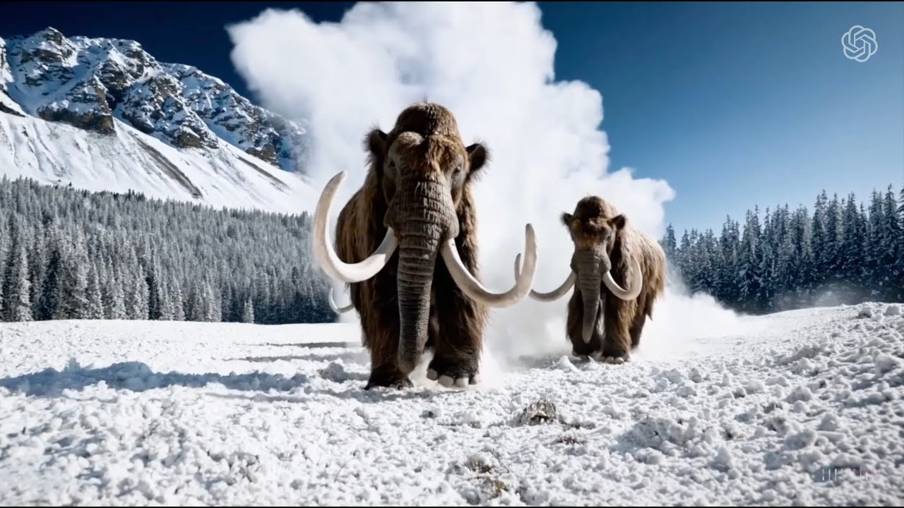

Slide 60
Scenario #5
A parent contacts you and says that they found a video of one of your teachers online that shows them seemingly involved in a drug deal. Yet you know that this parent and teacher have had a lot of conflict through the year. What are your next steps?

Slide 61
So how is AI changing education?

Slide 62
CHALLENGES AND
OPPORTUNITIES

Slide 63
Resources

Slide 64
AI: Destroyer of Education or a Tool?

Slide 67
FaithEdTech.org

Slide 68
AI and Education
Dave Black
Lutheran High School
David.Black@LHSParker.org
faithedtech.org

